Slide 1
VQ-Flows: Vector quantized Local Normalizing flows
CHRIS B. DOCK*
SAHIL SIDHEEKH*
TUSHAR JAIN
RADU BALAN
MANEESH SINGH
*-EQUAL CONTRIBUTION
Notes:
Slide #1 script:
Hi, in this work we present VQ-Flows: Vector quantized local normalizing flows.

Slide 2
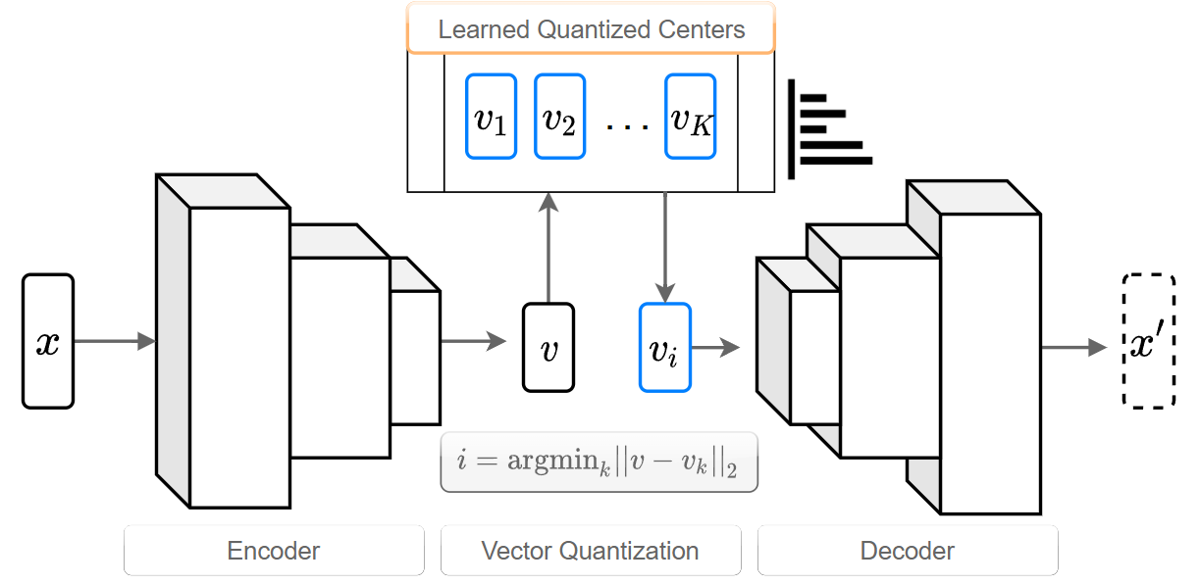
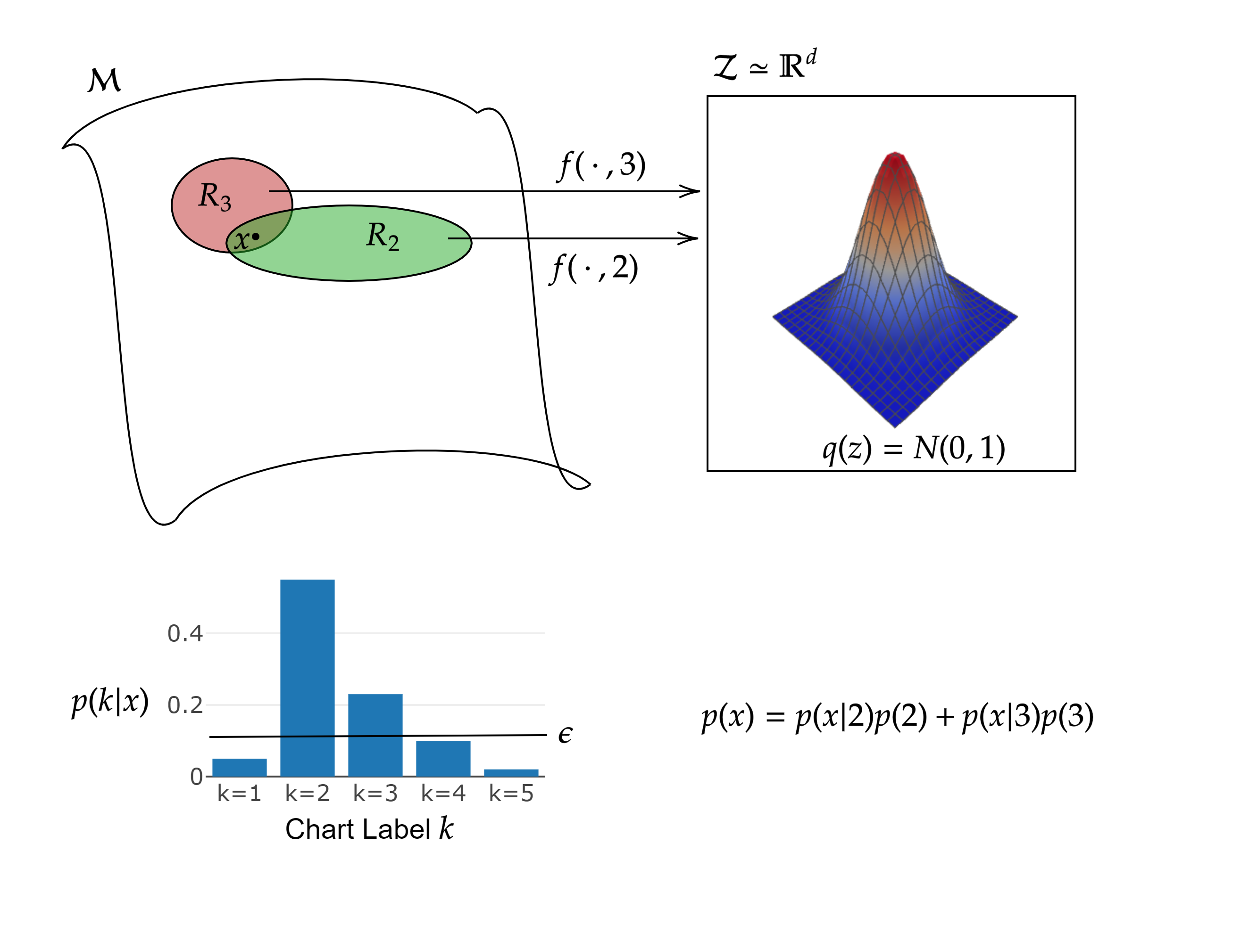
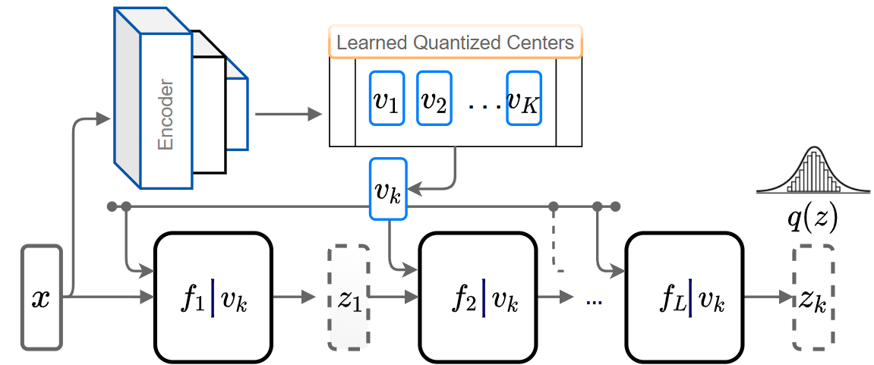
INTRODUCTION
CHALLENGES WITH FLOWS
Expressivity restrictions due to diffeomorphic requirement
Topological constraints
Dimensionality
PHASE 1
PROPOSED SOLUTION
Learn an atlas of local normalizing flows
Divide the data manifold into charts
Each local flow models the distribution within a chart
PHASE 2
Two phase learning
Learn charts over the data manifold using VQ-AE
Learn the data distribution local to each chart using a conditional flow
Improves expressivity while maintaining exact likelihood evaluation
Notes:
Slide #2 script:
Normalizing flows provide an elegant approach to generative modeling that allows for efficient sampling and exact density evaluation of unknown data distributions. However, the almost everywhere diffeomorphic requirement of flows implies that the data dimensionality, the topology and the smoothness is preserved almost everywhere through the latent spaces and the data space. This imposes significant limitations to their expressivity when the data is supported on a low- dimensional manifold or has non-trivial topology, as is the case with most real-world data distributions.
We address these issues by introducing a novel statistical framework for learning a mixture of local normalizing flows. Specifically, we propose a deep neural model that learns to model the global data distribution as a mixture distribution over an atlas of charts. The charts are indexed by a vector quantized auto- encoder (VQ-AE) and the distribution over them is modeled using a conditional normalizing flow. This model, called VQ-Flows, augments the expressivity of recent models while preserving exact density evaluation.

Slide 3
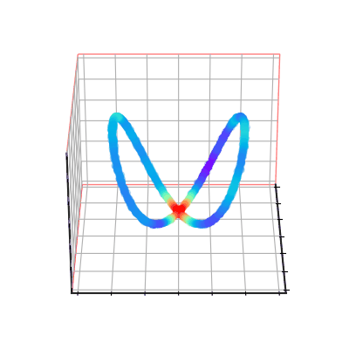
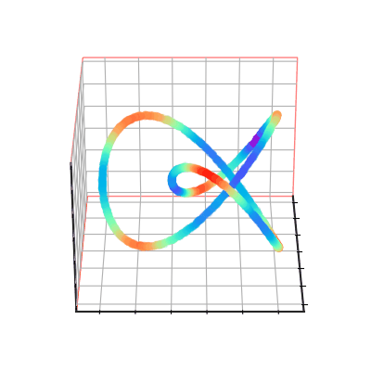
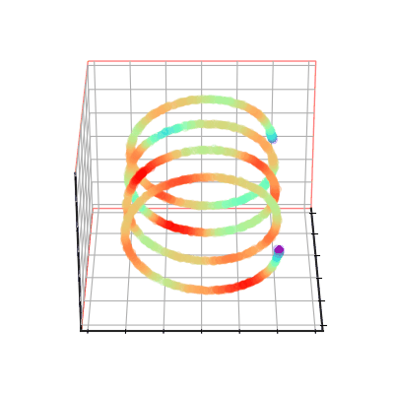
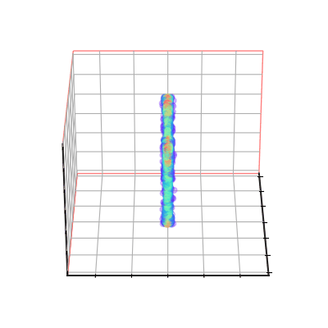
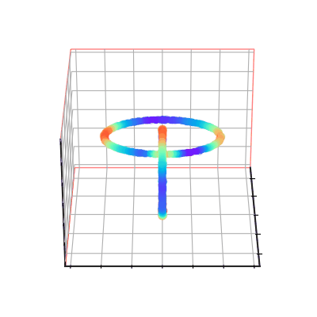
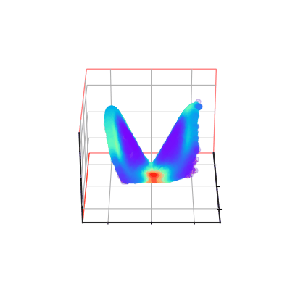
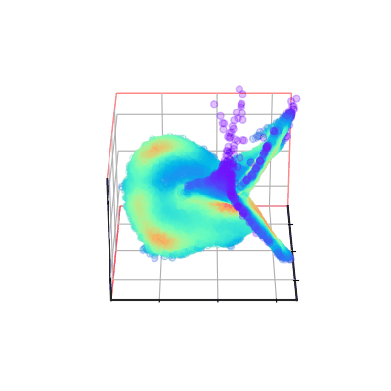
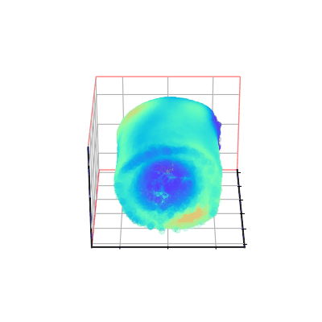
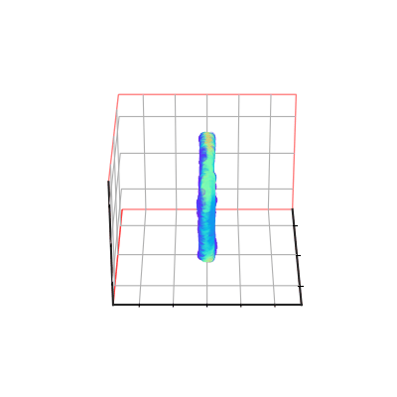
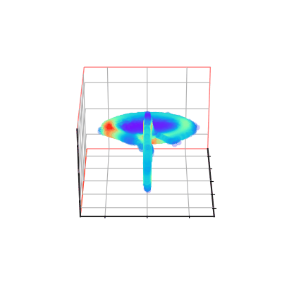
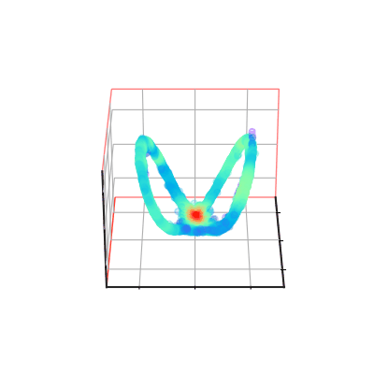
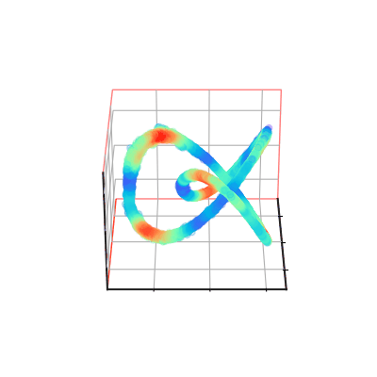
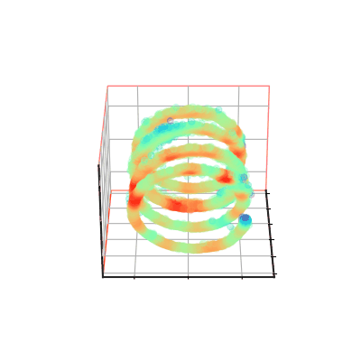
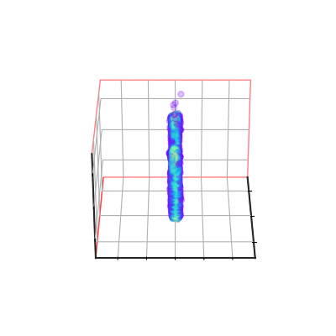
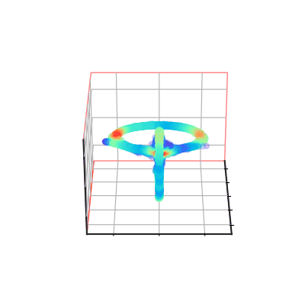
EMPIRICAL Results
REAL DATA
FLOW
VQ-FLOW
OURS
Notes:
Slide #3 Script:
The first row here depicts various data distributions over complex manifolds, the second row corresponds to how they are modeled by a classical flow and the third row demonstrates the improvement when our framework is augmented to it.

Slide 4
THANK YOU
For more details, scan:
Notes:
Slide 4:
For more details visit our poster or read our paper using the given QR code. Thank you

